Slide 1

COMP8325 Group Project
BY
ADITHYA SANJANA REDDY CHILUMULA (46130713)
SAI DIVYA KANDHADI (46724109)

Slide 2

Introduction
ML is a branch of AI that employs mathematical algorithms to discover patterns in the data and learn from them in the same way that humans do. In the field of cybersecurity, machine learning can detect abnormal user and system behaviour, and also learn from current dangers and predict unknown ones.

Slide 3
Machine Learning Techniques
Anomaly Detection:
One of most popular applications of machine learning is anomaly detection. Outlier detection aids in the prevention of fraud, cyber attacks, and network breaches, all of which can jeopardise an organization.
Machine learning in practical uses helps to speed up the anomaly detection method and to save resources. It can occur both after the fact and in instantaneously. In fraud detection and cybersecurity, for example, real-time anomaly detection is used to increase security and resilience.
Anomaly Models:
These are few models which are used in our project Isolation forest, Random forest tree, Decision tree, K-Nearest Neighbor (KNN)

Slide 4
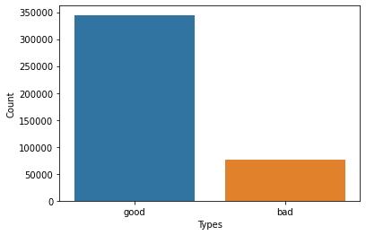
Malicious URL detection
In the malicious URL detection, there are two data sets namely URL Data Set (Matlab), and URL Data Set (SVM-light) Before we go into our strategy, it's essential to understand the different sorts of malicious URLs.
Plotted data against the good vs bad counts in the dataset

Slide 5
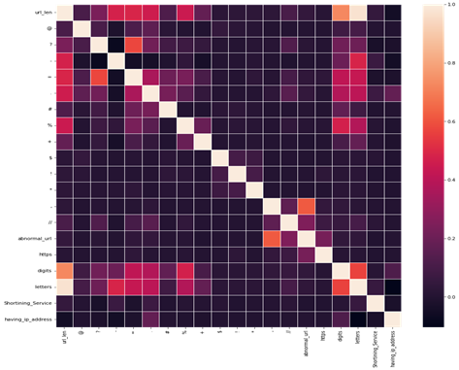
Malicious URL detection
Heat Map of the features extracted from the dataset

Slide 6
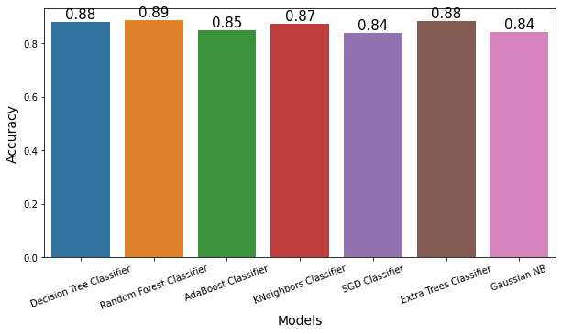
Malicious URL detection
Accuracy of the Analogy models.

Slide 7

Probing/Port scanning
Port scanning is a method of determining which ports on a network are open and could be receiving or sending data. It is also a process for sending packets to specific ports on a host and analyzing responses to identify vulnerabilities.

Slide 8
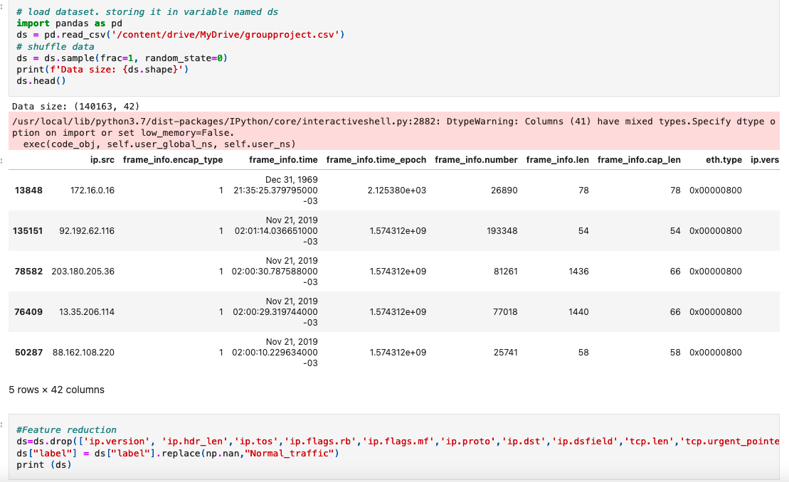
Probing/Port scanning Attack Detection

Slide 9
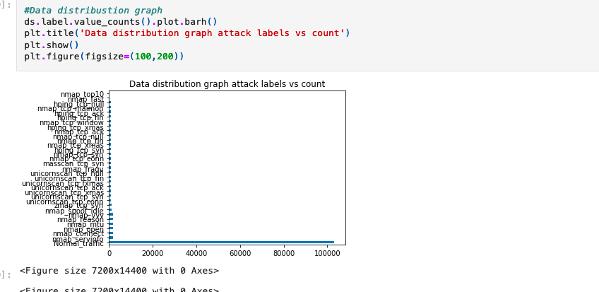

Slide 10
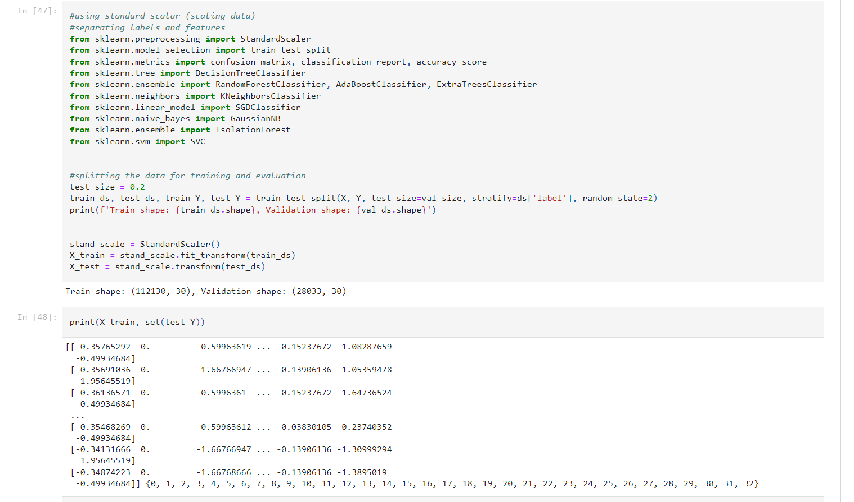
Probing/Port scanning Attack Detection

Slide 11
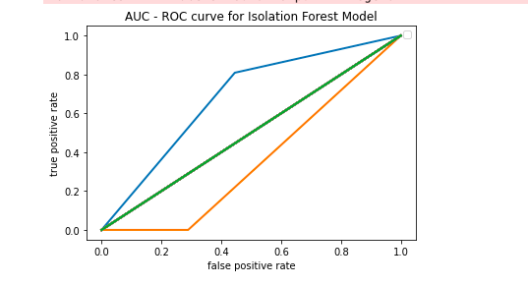
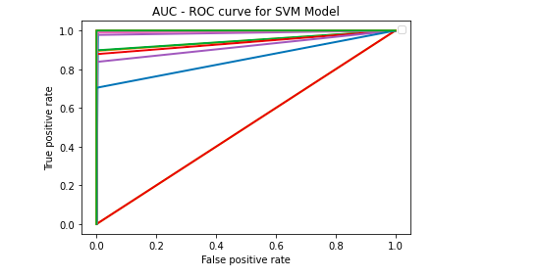
Comparison of AUC- ROC for ML Models

Slide 12
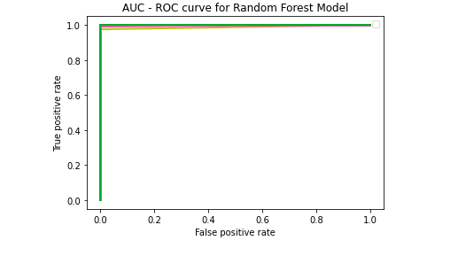
Comparison of AUC- ROC for ML Models

Slide 13
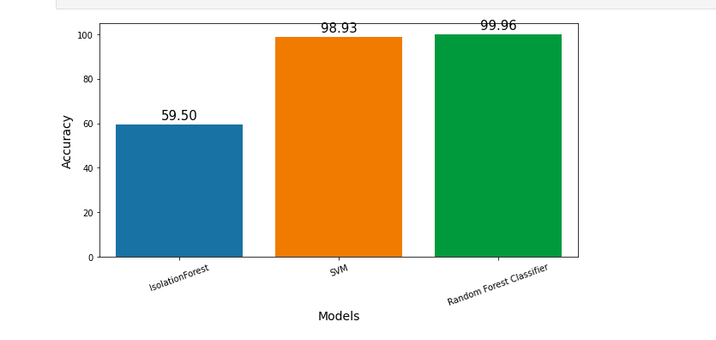
Accuracy score comparison for the ML Models

Slide 14
Conclusion
Machine learning has emerged as a critical technological advancement in the field of cybersecurity. It uses a variety of approaches to prevent digital threats and to strengthen the security foundation. Through this group project, we have learned to apply Machine Learning to solve cybersecurity threats such as port scanning attacks and phishing attacks for which we have built a port scan detection system and a malicious URL detection system respectively using various anomaly detection models.
Overall, we anticipate that machine learning will provide incremental advances to cyber defenders, but it is unlikely to fundamentally transform the industry barring additional breakthroughs. Some of the most transformative impacts may come from making previously under-utilized defensive strategies available to more organizations.
To conclude, machine learning in cyber security will be neither predominantly offense-biased nor defense-biased, it may subtly alter the threat landscape by making certain types of strategies more appealing to attackers or defenders.

Slide 15
Thank you.

